Slide 1



MediMap
MediMap is the first platform combining price transparency, prescription intelligence, and location-based pharmacy discovery.
Team Members:-
Parul
Mayank Bedi
Amit Bhushan
Dhanveen Mehta
Team Name :- SparkX

Slide 2

THE PROBLEM
Millions of Peoples struggle to afford their prescriptions. Prices vary wildly between pharmacies—sometimes by hundreds of rupees—yet this information remains hidden. For elderly, uninsured, and low-income individuals, this lack of transparency can mean choosing between medication and other essentials.

Slide 3




THE SOLUTION
Scan, Compare, Save - MediMap puts real-time prescription price comparison at your fingertips. Simply scan your prescription to instantly see prices at nearby pharmacies, complete with wait times and available coupons.

Slide 4



WHO WE SERVE
MediMap is designed for those who need it most—people facing real barriers to affordable medication. Our target users share a common challenge: stretching limited budgets while managing essential prescriptions.
Elderly on Fixed Incomes
Low-Income Families
Seniors managing multiple medications
Parents balancing tight budgets
Caregivers
Managing multiple prescriptions

Slide 5
PRESCRIPTION ANALYSIS
KEY FEATURES
The Prescription Analysis feature in MediMap helps users better understand their prescribed medications and make informed decisions about purchasing them.
MediMap combines smart technology with user-friendly design to make prescription savings accessible to everyone, everywhere.
INTERACTIVE MAP
View real-time prices, current wait times, and pharmacy locations on an easy-to-read map. Compare options at a glance and find your best route.

Slide 6
MEDIMAP FEATURES
Real-Time Pricing
Save Favorite Pharmacies
Pharmacy Locator Map
Accessibility Modes
Wait Time Estimates
Multi-Language Support
Sharp Tokens (Upcoming)
Price History Tracking

Slide 7
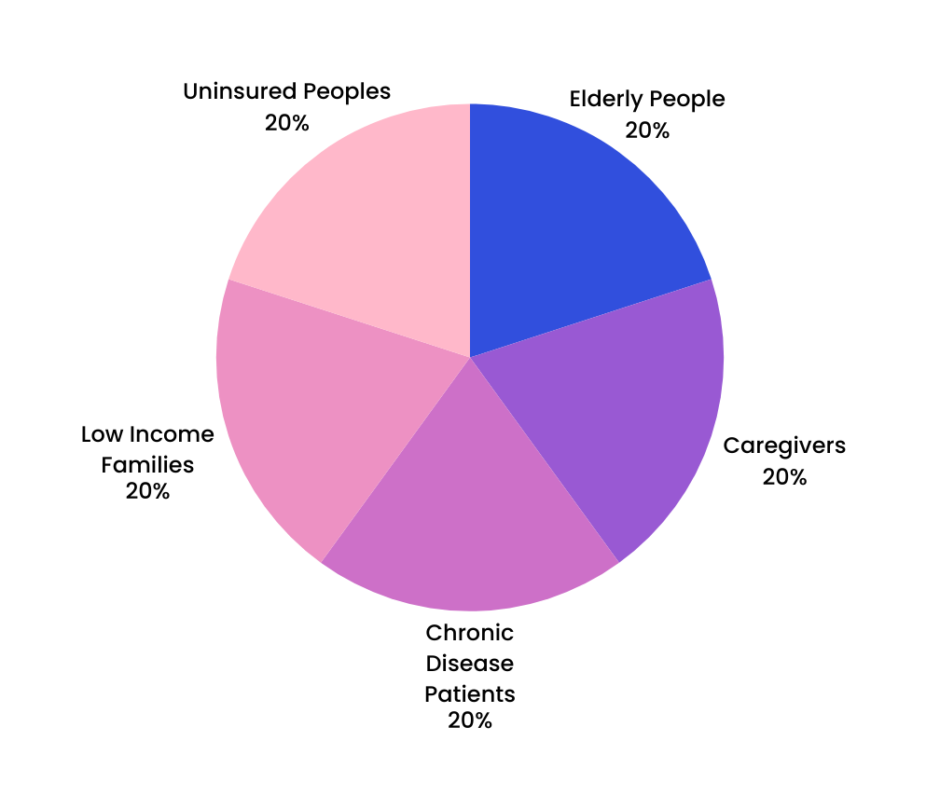

MARKET OPPORTUNITY
The prescription affordability crisis affects millions of Peoples who struggle to pay for essential medications. Our target market represents a massive underserved population actively seeking solutions to compare and reduce their prescription costs.

Slide 8


PROJECTED IMPACT
MediMap users can expect to save 30-40% annually on prescription costs. As our community grows, so does the accuracy of real-time pricing data, creating a positive feedback loop of savings.

Slide 9

OUR VISION
We envision a world where medication affordability is never a barrier to health. Through transparent pricing and community-powered data, MediMap empowers everyone to access the medications they need without financial stress.

Slide 10
FUTURE SCOPE
LAST-MILE DELIVERY
SHARP TOKENS
A dedicated delivery layer—partnering with local courier services—to bring affordable medication directly to the homes of homebound elderly patients or busy caregivers.
Access pharmacy-specific discounts and manufacturer coupons directly in the app. Stack savings to get the lowest possible price on your medications.
INSURANCE & HEALTHCARE INTEGRATION
MediMap can integrate with insurance providers, hospitals, and telemedicine platforms to automatically import digital prescriptions. This enables seamless medicine price comparison and helps users choose the most cost-effective pharmacy option.

Slide 11
THANK YOU!
LET'S MAKE HEALTHCARE AFFORDABLE TOGETHER

